Slide 1


The Evolution of Modern Architecture
@ShawnWallace
shawn.wallace@centricconsulting.com

Slide 2
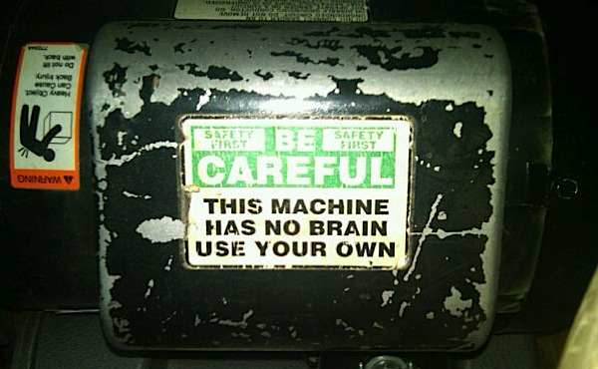
Notes:
These come from my experiences and research. You might have different opinions or I might just be wrong about some things.
How I came to go down this path.
looking for ways to orchestrate business processes in an enterprise without requiring specialized skillsets

Slide 3

A word about ‘productizing’ patterns and practices
Notes:
I’m going to use terms like
SOA
DEVOPS
ESB

Slide 4
Monolithic
Orders
Invoicing
Inventory
Logging
Warehouse
Profiles
Notes:
This is how a monolith is built
How agile killled this approach

Slide 5
Why NOT a Monolith?
A product of our agile approach to our projects…smaller features finished earlier.
Our business users frequently need to move faster than we can support.
The goal is to deploy more often…this often is hard with monoliths.
One solution is to have smaller (and smaller) applications.
Notes:
While our features are smaller, the testing effort hasn’t changed.
We can rely some on test automation, but even these test suites can get inflated.
I’m not trying to enter the debate.

Slide 6
Monolithic
Orders
Invoicing
Inventory
Logging
Warehouse
Profiles
Notes:
This is how a monolith is built

Slide 7
SOA
Orders
Invoicing
Inventory
Logging
Profiles
Warehouse
Notes:
Here is what we have done…

Slide 8
SOA
Orders
Invoicing
Inventory
Logging
Profiles
Warehouse
Tightly Coupled
Notes:
How do you do system-wide logging?
Mention ESB bus (expensive, requires specialized skillsets, did I say expensive).
Discoverablitiity
Addressing
Hard to change/test/deploy
Direct Dependencies are a problem

Slide 9

SOA with Enterprise Service Bus
Orders
Invoicing
Inventory
Integration Team
Enterprise Service Bus
Logging
Profiles
Warehouse
STILL Tightly Coupled
Notes:
How do you do system-wide logging?
Mention ESB bus (expensive, requires specialized skillsets, did I say expensive).
Going in the right direction

Slide 10
“Modular” Monolithic
Orders
Invoicing
Inventory
Logging
Warehouse
Profiles
Notes:
This is how a monolith is built

Slide 11
“The Role of the ESB still has its place — now in the form of a modern scalable message queue”
Source: Reactive Micoservices Architecture (Design Principles for Distributed Systems p. 34
Jonas Bonér

Slide 12
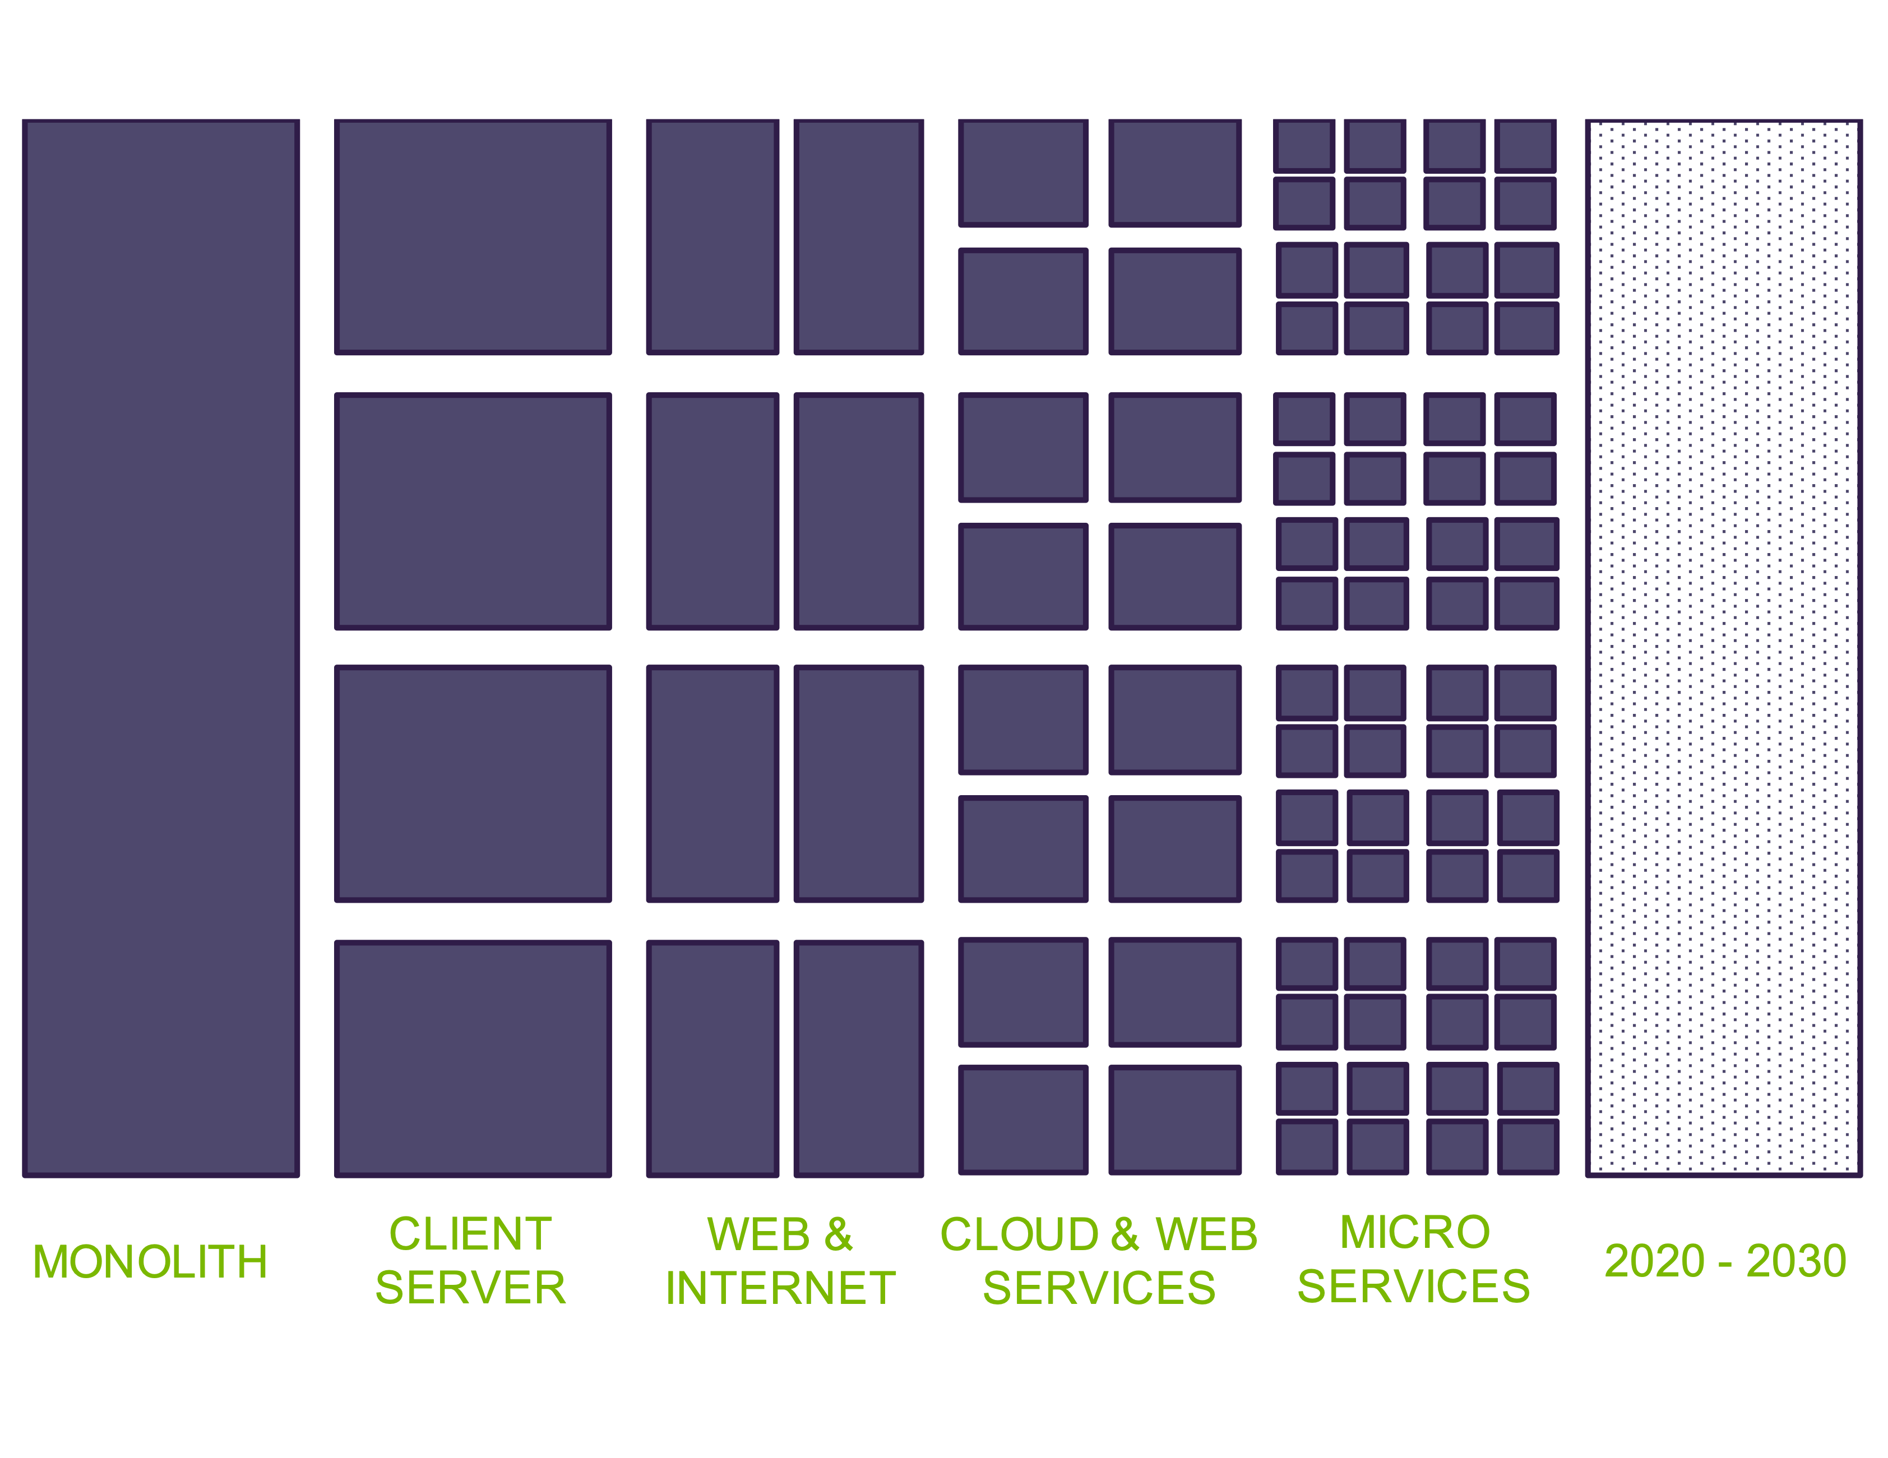
Notes:
You are probably somewhere on this continuum. Or maybe several places on it…
We are ALL cloud.

Slide 13
What are Microservices
Independently testable/deployable
Operate in isolation (loosely coupled)
Maintains own state
Asynchronous external interactions that favor message passing
Notes:
No really consensus…

Slide 14
Important Early Decisions
Embrace it
The basic thesis of this article is that organizations which design systems (in the broad sense used here) are constrained to produce designs which are copies of the communication structures of these organizations.
--- Melvin Conway
Notes:
Do our software systems do not create friction in the organization
Embrace it…

Slide 15
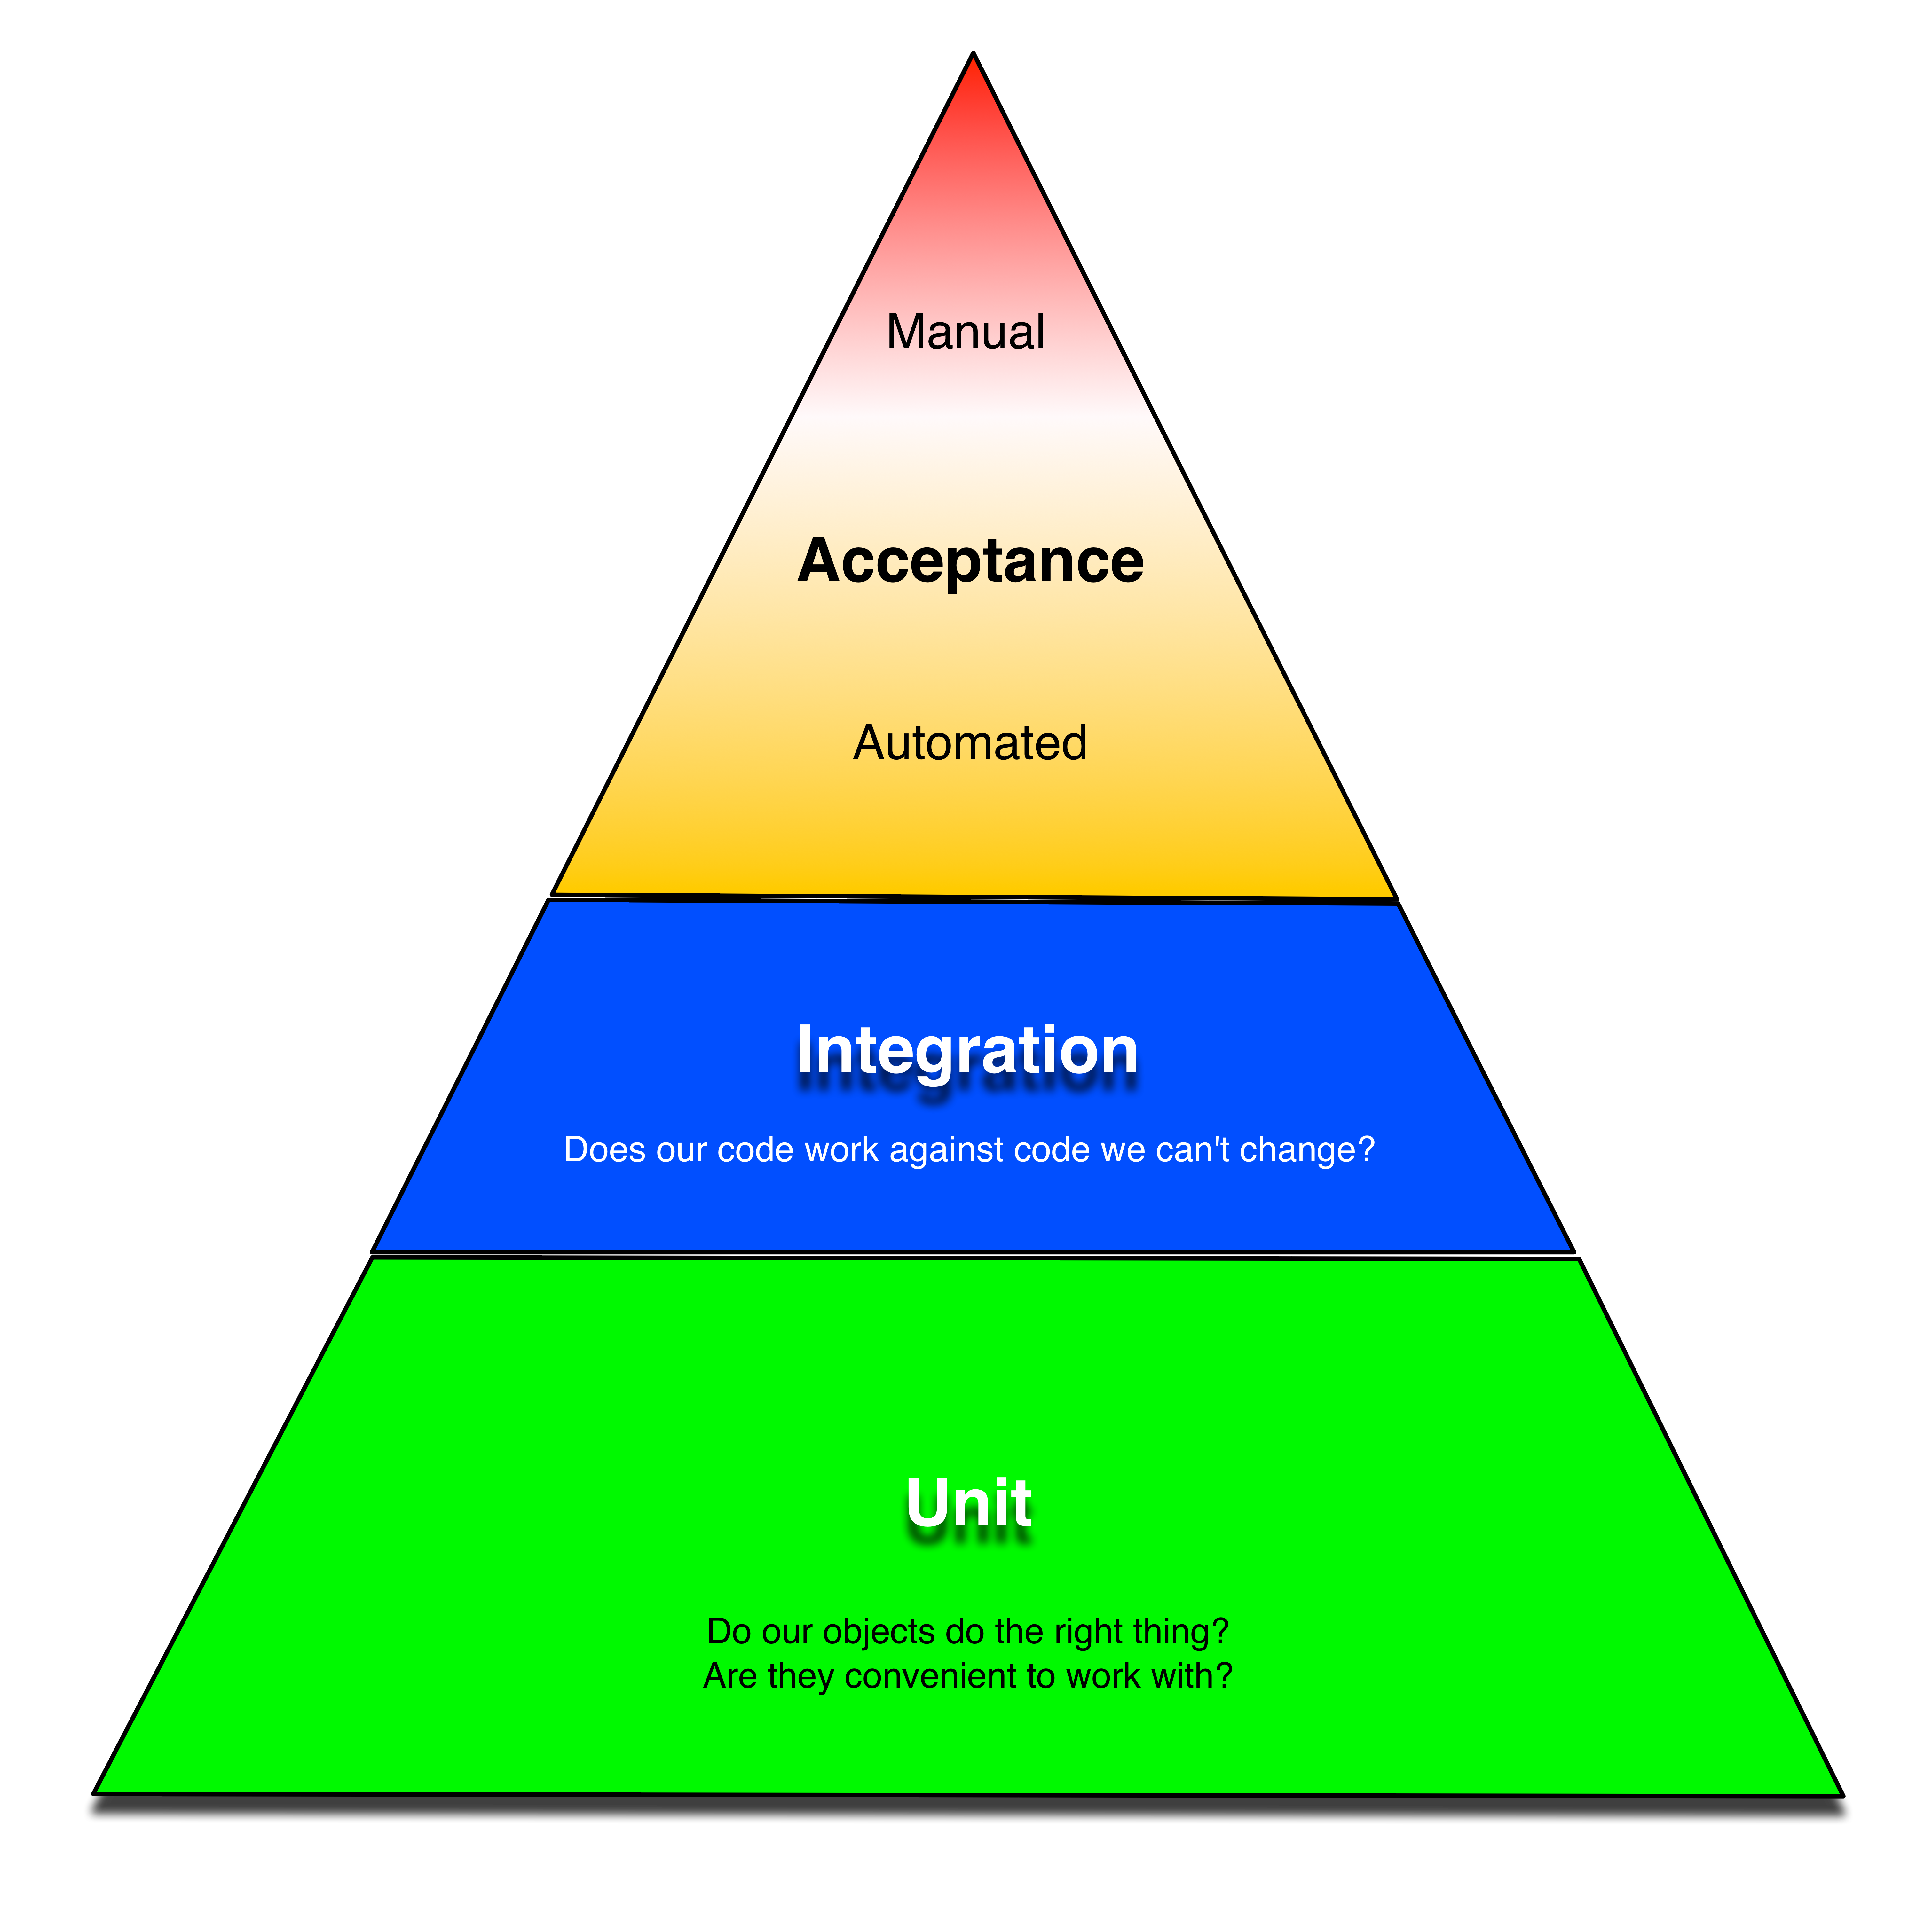
Be easy to test…
…so that you do.
Important Early Decisions
Notes:
Add a new subsystem and start consuming events that are already in the system

Slide 16
ReST is NOT your friend

Slide 17
Code Reuse is Overrated

Slide 18
Don’t I need Transactions?

Slide 19
Should Client Communication Still be Asynchronous?
Notes:
Clients often assume synchronous communication.
CQRS

Slide 20
We have to think about our data differently
Notes:
Clients often assume synchronous communication.
CQRS

Slide 21
We have to think about our data differently
Taking data from being OFFLINE to ONLINE
Moved from “data at rest” to “data in motion”
Real-time analytics, AI/ML
Batch processing not always practical
Notes:
Clients often assume synchronous communication.
CQRS

Slide 22
Scaling Model

Slide 23

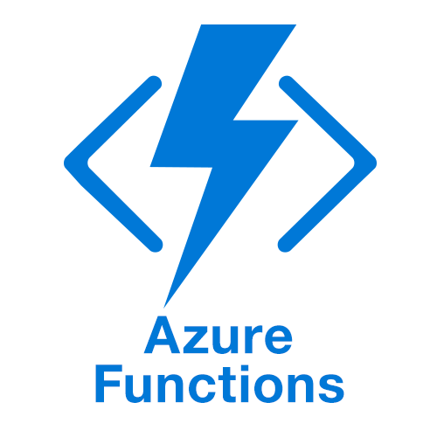
Scaling Model
Notes:
Support elastic, and granular scale

Slide 24
Monitoring/Logging/Troubleshooting

Slide 25
What problems are we solving?
Enable modernization/decoupling
Real-time/streaming processing
Modern elastic scalability
Integration
Flexibility/Speed/Adaptability
Resilience/Fault Tolerance
Asynchronous Communication
Business Process Implementation across an enterprise
Distributed Systems Communication
Testability

Slide 26
Event Driven Architecture
Event-Driven Architecture (EDA) is a software design paradigm that enables systems to react to and process events asynchronously, promoting loose coupling, scalability, and real-time responsiveness.
In EDA, events—representing state changes or business actions—are generated by producers, transmitted via an event backbone (such as Kafka, Azure Event Grid, or RabbitMQ), and consumed by one or more subscribers that react to them independently.
This decoupled communication model allows systems to evolve without requiring direct dependencies between services, making it ideal for microservices, IoT, real-time analytics, and cloud-native applications.
By leveraging event streams, organizations can build more resilient, adaptable, and efficient architectures that seamlessly integrate disparate systems while improving observability and responsiveness.

Slide 27
Event Driven Architecture
An Event represents something that happens in a domain
Customer Submits Order
Customer Billed
Payment Received
Order Ready for Shipment
Order Shipped
While Events and their payload are designed at the enterprise system level, their implementations are left to the specific subsystems.

Slide 28
Event Driven Architecture - Business Capability
Dynamic scaling
Speed to market
Governable
Workflow
Analytics
Notes:
Trade application complexity for infrastructure complexity

Slide 29
Event Driven Architecture - Technical
No point-to-point integrations
Loosely coupled, highly scalable systems
Loosely coupled, TEAMS
Easier to test
Easier to change
Technology agnostic
Notes:
Trade application complexity for infrastructure complexity

Slide 30
Event Driven Architecture - Team
Developer centric
Team skills
Incremental Implementation
Non-invasive
Admininsterable
Notes:
Trade application complexity for infrastructure complexity

Slide 31
EDA Composition

Slide 32
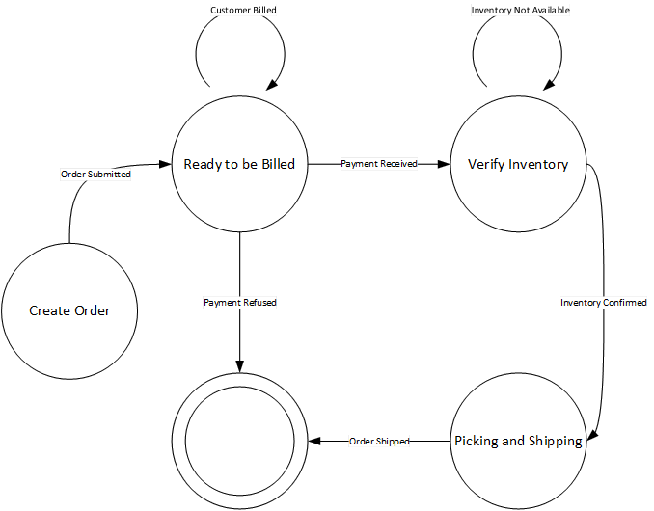
Easily Modeled as a finite state diagram
Notes:
I’m hesitant to keep recommending this. I still think it provides value.

Slide 33
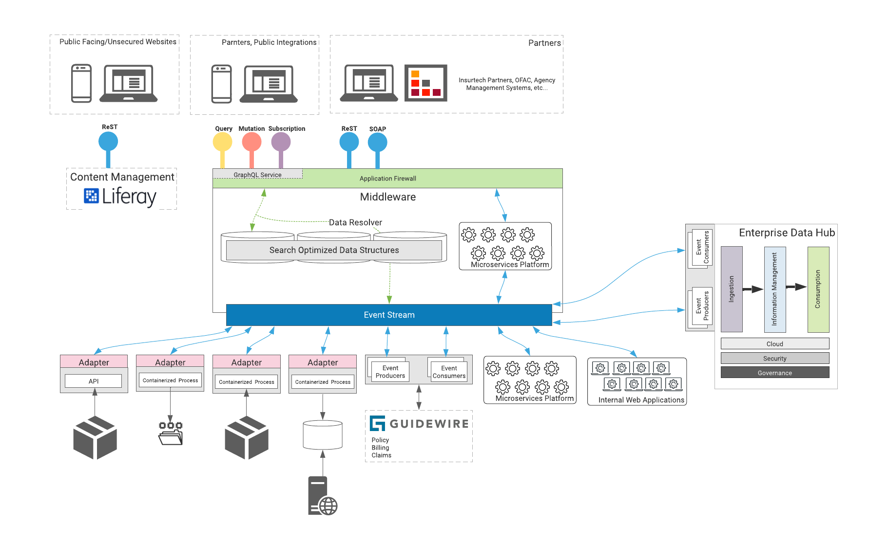

Slide 34
”Types” of Events
Domain – communicate a domain state change
Integration – notify of changed across domains/networks
System - telemetry
Temporal – scheduled
Platform – infrastructure health and status
Policy – telemetry events focused on governance
User/Actions – analytics
Data – mutations to data (change data capture)

Slide 35
”Types” of Events
Domain – communicate a domain state change
Integration – notify of changed across domains/networks
System - telemetry
Temporal – scheduled
Platform – infrastructure health and status
Policy – telemetry events focused on governance
User/Actions – analytics
Data – mutations to data (change data capture)

Slide 36
Important Early Decisions
Embrace Asynchronous Interactions
Communication Pattern
Logging Infrastructure
Notes:
don’t be too dogmatic

Slide 38
API Gateway

Slide 39
Function as a Service
Client
Client
Client
Api Gateway
Function
Function
Function
Orchestration

Slide 40
Function as a Service
Client
Api Gateway
Function
Function
Function
Orchestration
Notes:
How should the applications functions talk to each other?

Slide 41
Function as a Service
Client
Api Gateway
Function
Function
Function
Event Stream

Slide 42
Event Stream

Slide 43

Loosely Coupled
Orders
Invoicing
Inventory
Event Stream
Logging
Profiles
Reporting

Slide 44
Easy to Integrate New Systems
Orders
Invoicing
Inventory
Event Stream
Logging
Profiles
Reporting
New System
Notes:
Add a new subsystem and start consuming events that are already in the system

Slide 45
Scales
Inventory
Inventory
Inventory
Orders
Invoicing
Inventory
Event Stream
Logging
Profiles
Reporting

Slide 46
Addresses “Data in Motion”
Orders
Invoicing
Inventory
Event Stream
Logging
Profiles
Reporting
Business Intelligence/Data & Analytics
Notes:
BI consumes events

Slide 47
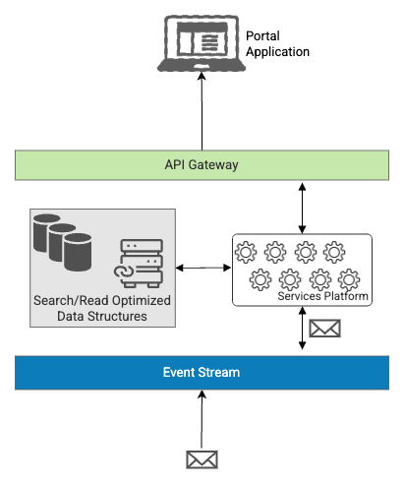
Eventual Consistency
Data in Motion
Denormalization for Fast Queries
Asynchronous Updates
Schema Design for Performance
Efficient Data Storage & Querying
Data Synchronization with Event Streams
Optimized Caching
Supports High/Dynamically Scaled Throughput

Slide 49
The basic thesis of this article is that organizations which design systems (in the broad sense used here) are constrained to produce designs which are copies of the communication structures of these organizations.
--- Melvin Conway
Notes:
Do our software systems do not create friction in the organization

Slide 50
Other benefits
Ease of 3rd party integration
Existing systems can be ‘wrapped’
Can be deliberate about scaling
Fault tolerant
Event messages can be logged and ‘replayed’
Can test subsystems in isolation

Slide 51
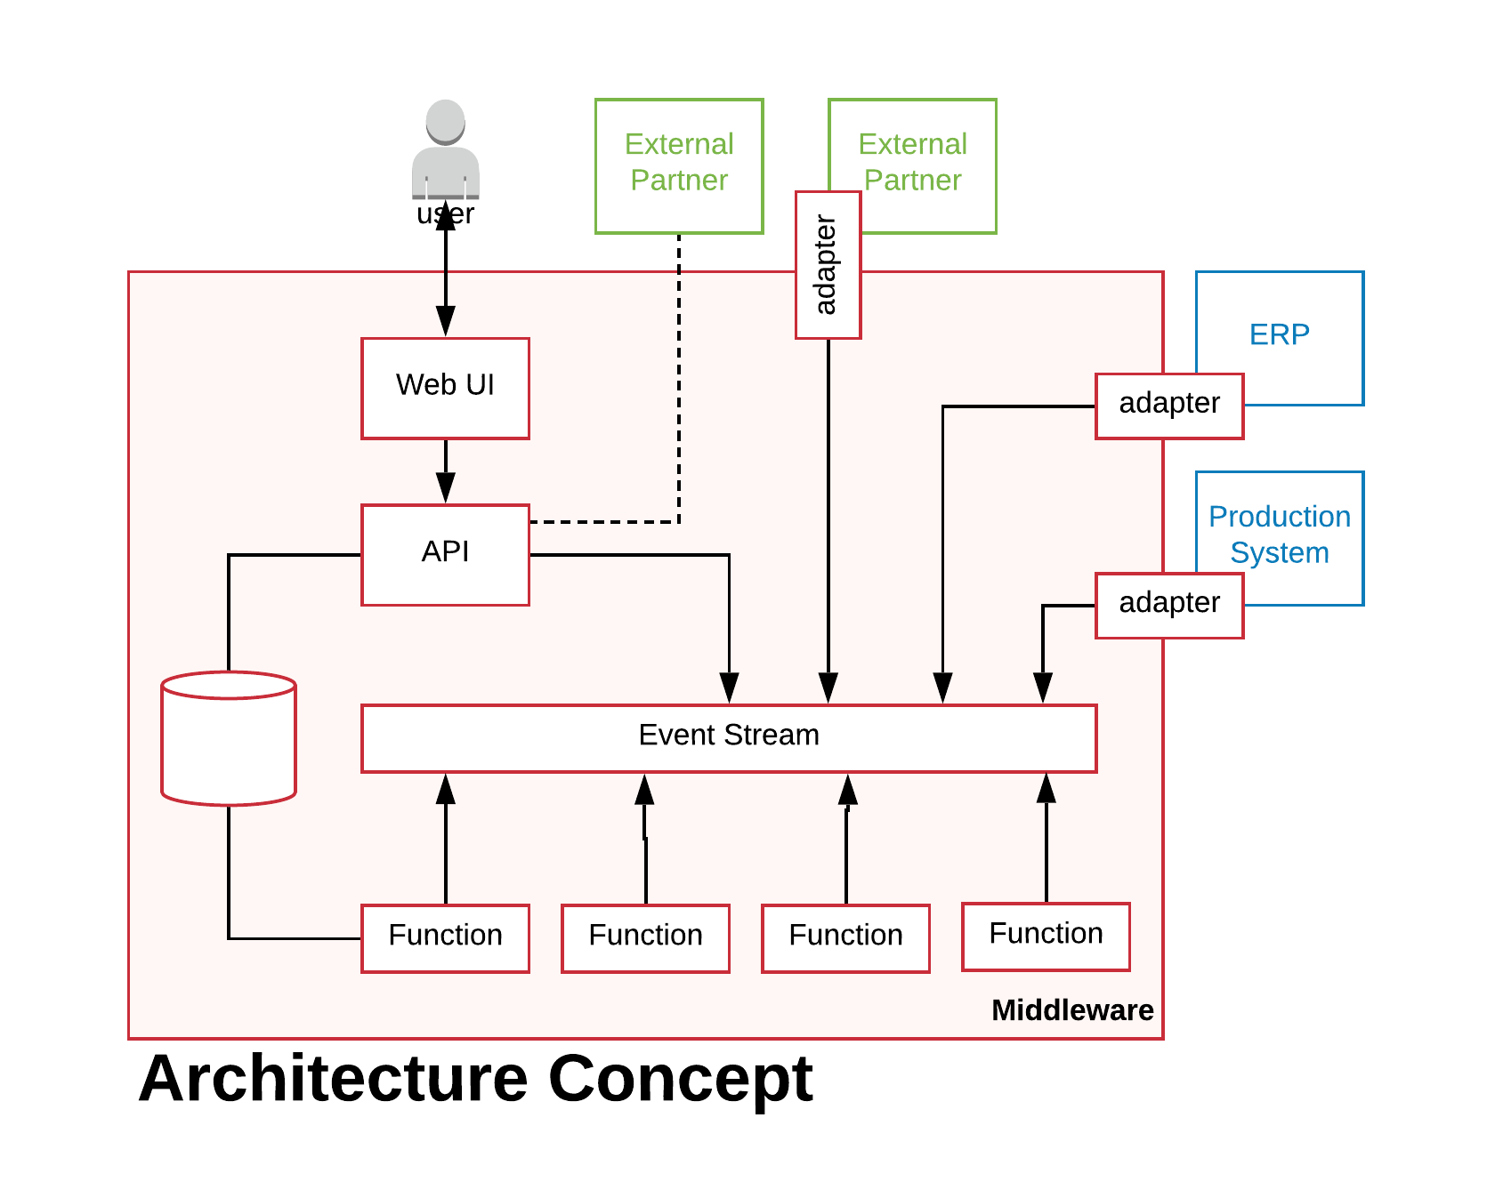
A Retail System

Slide 52
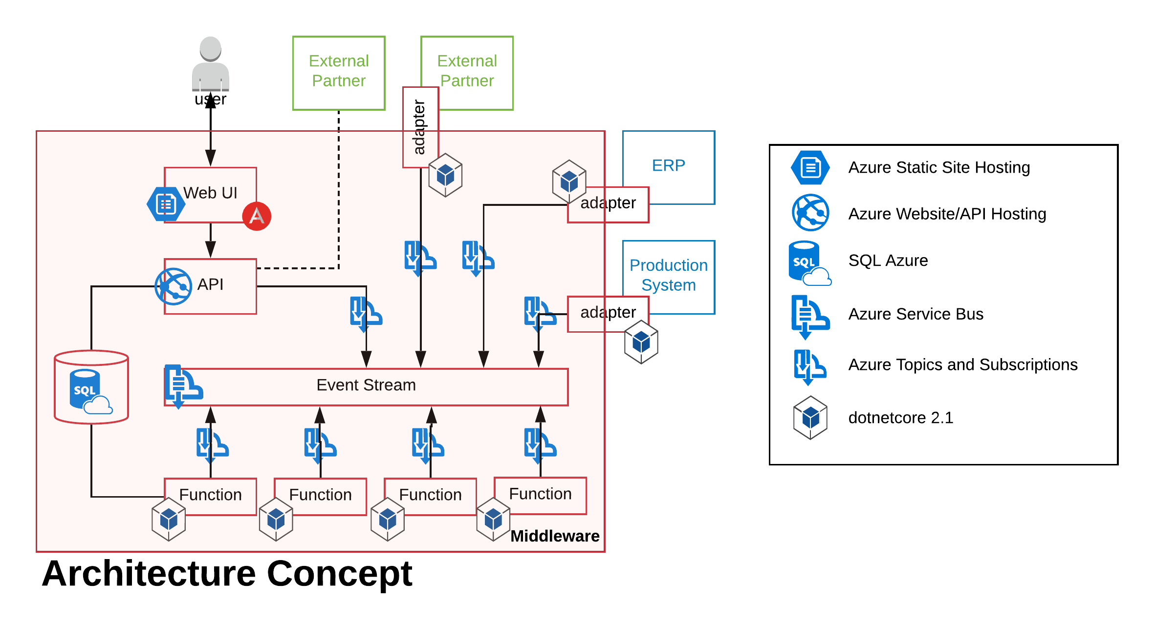
A Retail System

Slide 53
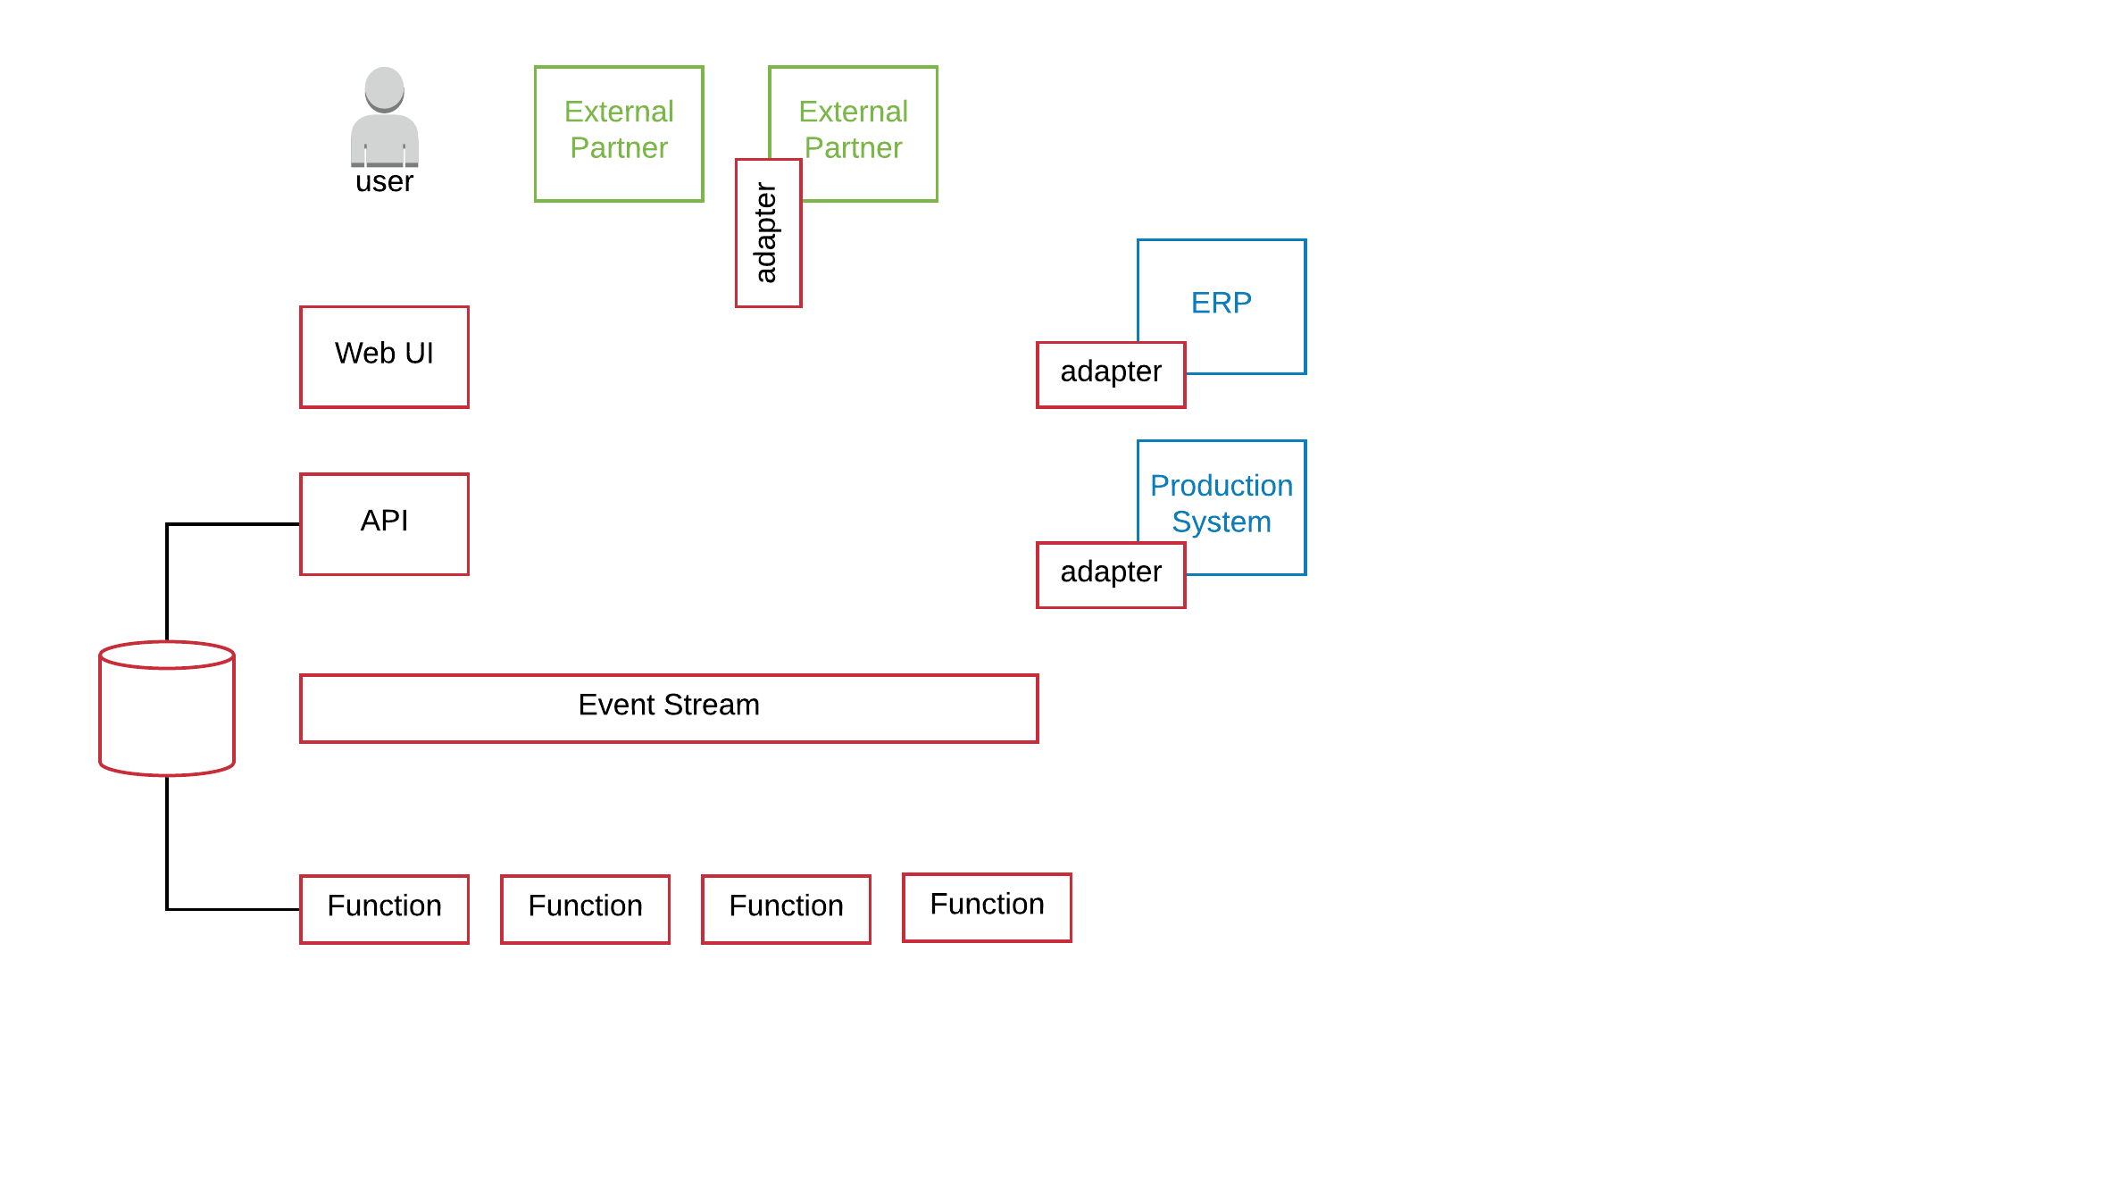

Order Created Event is generated by a User
Invoicing
Shipping
Warehouse
Logger

Slide 54
Customer Billed Event
Invoicing
Shipping
Warehouse
Logger

Slide 55
Item Produced Event
Invoicing
Shipping
Warehouse
Logger

Slide 56
Order Shipped Event
Invoicing
Shipping
Warehouse
Logger

Slide 57
The Logger consumes EVERY event
Invoicing
Shipping
Warehouse
Logger

Slide 59
Event Sourcing

Slide 60
Event Sourcing
Events are immutable
Events describe the action
Eventually consistent data
Embraces CQRS

Slide 61
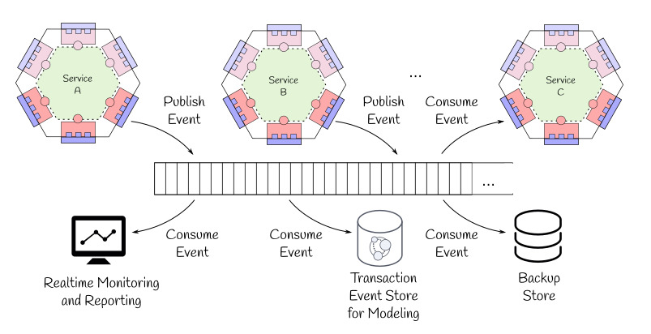
Event Sourcing
Image via: Microservices with Clojure
Notes:
This concept has promise, I’m not good at it yet.

Slide 62
For Further Reading
THIS presentation (and code) on GitHub
https://github.com/shawnewallace/eda-rabbitmq
Stephan Norberg EDA
http://www.infoq.com/presentations/Domain-Event-Driven-Architecture
“Programming Without a Call Stack”
http://www.enterpriseintegrationpatterns.com/docs/EDA.pdf
“Event-Driven Architecture Overview”
http://www.omg.org/soa/Uploaded%20Docs/EDA/bda2-2-06cc.pdf
“…Event Sourcing is Hard”
https://chriskiehl.com/article/event-sourcing-is-hard

Slide 63
Event-driven architecture is a versatile approach to designing complex software systems. These systems tend to be easier to model for an organization as EDA embraces Conway’s Law and can often be modeled as a finite state machine. Event-driven architecture is not a new concept, but as more organizations embrace micro services, this approach to system design has become appropriate in more situations. In this talk we’ll: introduce event-driven architecture, talk about key components, look at a sample implementation of a retail system.

